Slide 1
Quantitative Methods Lecture-1

Slide 2
Important class rules
Rule #1: Two way communication
Answer questions using the chat box
Type – “yes” or “y” in the chat box to confirm you understand
I will wait for answers before moving forward
Rule #2: Participate
Learning by doing (keep your spreadsheet open)
Use chat box / raise your virtual hand to ask questions
Do you know how to raise hand? (Type “y” in the chat box if yes)
Rule #3 Utilize Q&A
Clarify your remaining questions at the end of the session

Slide 3
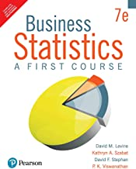
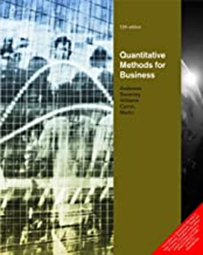
Textbooks
This course has two textbooks.
Business Statistics
Business Statistics: A First Course by D.M. Levine, T.C. Krehbiel, M.L. Berenson and P. K. Viswanathan. Seventh edition.
Pearson Education.
Available at Amazon
Management Science/Optimisation
Quantitative Methods for Business. David R Anderson, Dennis J Sweeney, Thomas A Williams, Jeffrey D Camm and Kipp Martin. Twelfth edition.
Cengage Learning. 2013.
Available at Amazon

Slide 4
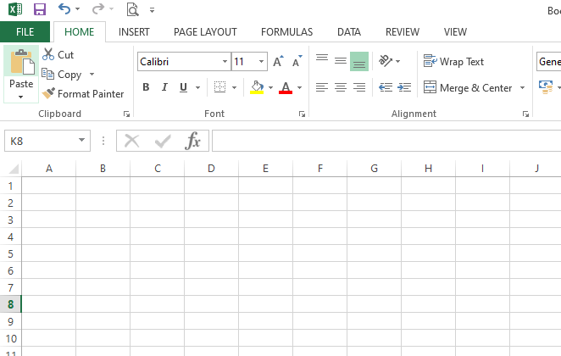
Course coverage
Business Statistics
Data collection, presentation, basic probability, estimation, hypothesis testing, correlation, and regression.
Management Science
Optimisation techniques- Linear programming, transportation problems, and assignment problems.
Practice
Solve problems in MS Excel/ any other software.

Slide 5
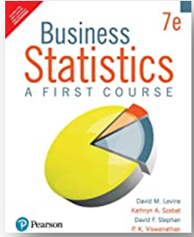
Syllabus - Refer to the course handout
Textbook # | Chapter # | Chapter Title
1 | 1 | Defining and Collecting Data
1 | 2 | Organizing and Visualizing variables
1 | 3 | Numerical Descriptive Measures
1 | 4 | Basic Probability
1 | 5 | Discrete Probability Distributions
1 | 6 | The Normal Distribution
1 | 7 | Sampling Distributions
1 | 8 | Confidence Interval Estimation
1 | 9 | Fundamentals of Hypothesis Testing: One-Sample Tests
1 | 10 | Two-Sample Tests and ANOVA
1 | 11 | Chi-Square Tests
1 | 12 | Simple Linear Regression
2 | 7 | An Introduction to Linear Programming
2 | 9 | Linear Programming Applications in Marketing, Finance, and Operations Management
2 | 10 | Distribution and Network Models
Mid-Term Test Syllabus
Textbook #1
Comprehensive Exam Syllabus
Textbook #2

Slide 6
Course handout and Evaluation
Course handout is available at Taxila.
Textbooks, Reference books, Topics, Delivery plan …
Evaluation scheme- (Evaluation Component, EC)
No | Name | Weight | Date(s)
EC-1 | Quizzes & Assignments | 25% | Will be announced shortly, by the faculty
EC-2 | Mid-Semester Test | 35% | As announced by WILP
EC-3 | Comprehensive Exam | 40% | As announced by WILP

Slide 7
Why Quantitative Methods?
Start using data and quantitative analysis for your business decisions
Decisions: Qualitative inputs vs. quantitative inputs
Annual performance evaluation
Important to see the big picture behind the numbers
How does marketing budget affect sales?
Cut-throat competition for the market share, profitability, goodwill, etc.
Playing with trade-offs
Making best use of the limited resources

Slide 8
Some more examples
Which customer segment is most satisfied with our service?
Which of the employees should be given a promotion under budget limitations?
Is there a relationship between the customer’s gender and the color preference of the car?
Is a newly developed Covid-19 Vaccine safe?
How do I create a portfolio for maximizing the return to risk ratio with limited budget?
What product mix should be manufactured in a factory?
How to split marketing budget for maximum returns: acquisition vs. retention?

Slide 9
QM can be applied to intangible constructs also
Anything that cannot be measured cannot be improved.
The pursuit of discovering the reasons behind any phenomenon
Brand Recall
Customer experience
Employee Performance
Investor Perceptions

Slide 10
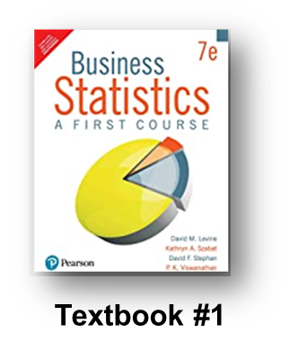
Chapter-1: Defining and Collecting data

Slide 11
Topics
Chapter-1: Defining and Collecting Data
Defining variables
Collecting data
Types of sampling methods
Types of survey methods

Slide 12
Data and Variables
Start with your business objective
Define data that you want to collect to achieve that
Example: Employee performance review
What kind of data will help you achieve this objective?
Collect data
How do you collect this data?
Organize and visualize
What is the distribution of employee performance in your department?
Analyze to answer business questions
Top 5% get 20% raise etc.

Slide 13
Data and Variables
Variables
Features, characteristics or columns of a record
What are the variables in the sales record table shown below?
Type in the chat box!
Data
Values of those features
What is data against features in the sales record table?
Customer | Customer Name | Annular Purchase
1 | Rohit | Rs 1459.00
2 | … | …

Slide 14
Variable Types
Categorical
Gender? Type of customer (business or home)?
Numerical
Discrete
Countable 0,1,2,3,…
Number of purchases in a year?
Continuous
Take any finite value
Depends on precision of the instrument (4.56 or 4.5678 etc.)
Sales amount?
Everyone should download store_inventory.xlsx file
Work with the data and confirm the understanding
Ask questions if you are not able to or raise your virtual hand to ask the question
Which of the store_inventory.xlsx
data Categorical, Discreet or Continuous?

Slide 15
Topics
Chapter-1: Defining and Collecting Data
Defining variables
Collecting data.
Types of sampling methods
Types of survey methods

Slide 16
Data Sources
Primary sources
You collect the data first hand (Examples?)
Surveys
Personal contact, phone, email, online etc.
Experiments
Randomized trials (Covid vaccine?)
Business activity
Production process
Secondary sources
You use the data collected by other sources?
https://reuters.com/
List of prospects (leads)
Is store_inventory.xlsx data primary or secondary?

Slide 17
Data Sources
Structured data (?)
Can be neatly organized as tables
Unstructured data (?)
Texts / Tweets
Sentiment analysis
Are customers saying positive things about my brand?
Images
Pictures of products to determine faults
Videos
Which ad evokes positive reactions?
Is store_inventory.xlsx data structured or unstructured?

Slide 18
Answering business questions with data
Population or Sample?
Population study: We use data from all the units for analysis
Sample study and inference
We use data from a carefully drawn sample of the population
We infer population parameters from the sample analysis
What is the mean height of this class?
Is Population study possible? (Type “y” in the chat box if yes)
Data from all the units can be collected and used for the analysis
Exit poll (who is likely to win the election?)
Is collecting data from entire population possible?
A sample from the population is used to answer the question

Slide 19
Sampling Methods
Let’s look at store inventory data again
Let’s try to answer the question of
“What is the average inventory quantity of items in the shop”?
Can we use any type of sample to answer our question?
If we take first 10 items will our estimate of average for the whole store accurate?
What do we need to ensure that our answer is approximately right?
The sample should be “representative of the population”
Do we understand this statement? (Type “y” if you do)

Slide 20
Type of Sampling Methods
Non-probability sampling
Judgement sample (when do we use this?)
Convenience sample (When do we use this?)
Probability Sampling
Simple Random Sampling
Systematic Sampling
Stratified Sampling
Cluster Sampling

Slide 21
Simple Random Sampling
Every item has same chance of selection
Sampling Frame: List of all units in the population
Draw a random sample of “n” items from the “Sampling Frame” of “Items”
What is the probability that a given item would be drawn in the first picking?
1/N
Sampling with replacement
Sampling without replacement

Slide 22
Simple Random Sampling
Draw a random sample of 10 items from store inventory data
Create a new column, name it “Random Number”
Generate random numbers with formula: RANDBETWEEN (1,100)
Populate this entire column with random numbers
Sort data by column “Random Number”
Pick first 31 numbers
Calculate average of these 31 randomly picked items
Calculate population average
How does the sample average compare with the population average?

Slide 23
Limitations of Simple Random Sampling
May not be feasible
Is drawing random sample of 10,000 residents from Mumbai’s population possible? (~2.2 crores transient population)
May be very expensive
May not represent all logical groups of the population
Is this 10,000 sample likely to represent extreme minority groups?
With less than 1% population proportion?

Slide 24
Systematic Sampling
Start from a randomly selected item
Take every k^{th} item sampling frame
With/after-class practice
Sort inventory data with random number column
Take every 3rd item from the list
Calculate average of inventory quantity from this systemic sample
Calculate population average
How does the sample average compare with population average?

Slide 25
Stratified Sampling
Divide the population into logical subpopulations
Members of certain state, cast, religion, locality
Draw a simple random sample from each sub-population
With/after-class practice
Use inventory data item types as sampling strata
Sort inventory data by item type
Draw a random sample of 4 items from each type
Combine them to make a stratified sample
Calculate average of inventory quantity from this stratified sample
Calculate population average
How does the sample average compare with population average?

Slide 26
Cluster Sampling
In certain situations pure random sampling is
Not desirable, infeasible or very expensive
Examples – experiments
We could chose cluster sampling in such cases
Clusters are logically occurring groups
Apartment communities in a city
Certain block of residents
Patients arriving in particular hospitals
Clusters are defined and n-clusters are randomly chosen
All units from chosen clusters become part of the sample

Slide 27
Cluster Sampling
With/after-class practice: In the given inventory data
Treat items from suppliers as clusters
Make a list of unique clusters
Randomly select 4 clusters
Calculate average inventory quantity from the sample data
Compare it to the population average

Slide 28
Today’s content
Why quantitative methods?
Variables and data
Survey methods
Sampling methods introduction

Slide 29
Q&A
Questions about
Objectives
Content
Anything else

